Slide 1
Chapter 17: Additional Aspects of Aqueous Equilibria
AP Chem 2019

Slide 2
Chapter 17 Problem Set

Slide 3
Chapter 17 Topics
17.1 Common Ion Effect
17.2 Buffers
17.3 Titrations!
17.4 Solubility Equilibria
17.5 Factors of Solubility
17.6 Precipitation and Separation of Ions

Slide 4
17.1 Common Ion Effect
Common ion effect - extent of ionization of a weak electrolyte is decreased by adding to the solution a strong electrolyte that has an ion in common with the weak electrolyte
Example:
Combination of acetic acid (weak electrolyte) and sodium acetate (strong electrolyte)
What determines the strength ?

Slide 5
17.1 Common Ion Effect
If we combine these two solutions…
We are increasing acetate ion in solution causes the equilibrium to shift left by consuming H+

Slide 6
17.1 Common Ion Effect Example
Example 17.1:
0.3 mol NaC2H3O2 and 0.3 mol HC2H3O2 are combined in enough water to make 1.0 L.
What is the pH?

Slide 7
17.2 Buffered Solutions
Buffers - resist drastic changes in pH upon the addition of small amounts of strong acids or bases
Applications
Calibration of pH meters (depends on range)
Blood (bicarbonate buffer)
Seawater (bicarbonate buffer)
Custom media

Slide 8
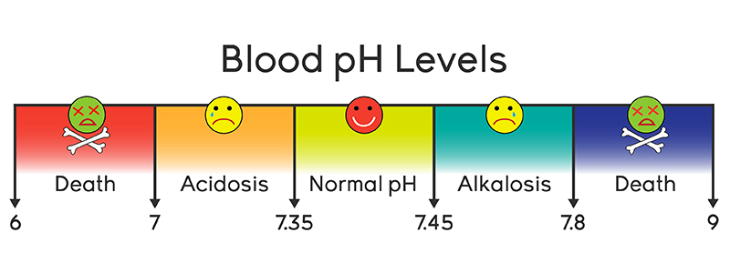
17.2 Buffers and Blood

Slide 9
17.2 Buffered Solutions
How do buffers work?
Buffers contain both basic and acidic species
Acidic species can neutralize OH-
Basic species can neutralize H+
Typically formed by a weak-acid base conjugate pair such as
HC2H3O3 and C2H3O2-
NH4+ and NH3
They also must not neutralize each other, so typically a weak acid is combined with a salt of that acid

Slide 10
17.2 Buffered Solutions
Determining how a buffer works:
Dissociation equation
HX (aq) <—> H+ (aq) + X- (aq)
Eq. expression
Ka = [H+][X-]/[HX]
Solving for [H+]
[H+] = Ka*[HX]/[X-]

Slide 11
17.2 Buffered Solutions
Based on the dissociation equation….
HX (aq) <—> H+ (aq) + X- (aq)
Adding OH- decreases H+, increasing X- in solution
Adding H+ decreases X-, increasing H+ in solution
The ability to resist change in pH is dependent on the amount of HX and X- in solution

Slide 12
17.2 Buffered Solutions
HF (aq) <—> H+ (aq) + F- (aq)

Slide 13
17.2 Buffered Solution: Calculating pH of buffers
Conjugate acid - base pairs share a common ion
Therefore we can use the same technique we used in common ion effect but…
Henderson Hasselbach equation is more commonly used
Derived from [H+] = Ka*[HX]/[X-]
Determining the pH of a buffer allows a scientist to design buffers in specific ranges

Slide 14
17.2 Buffered Solutions: Deriving Henderson Hasselbach
[H+] = Ka*[HX]/[X-] (neg. log both sides)
-log[H+] = -logKa - log[acid]/[base] (log rules)
pH = pKa + log [c.base]/[acid]
pH = pKa + log [c.base]/[acid]
when c. base = acid
pH = pKa

Slide 15
17.2 Buffered Solutions
Ex. 1
What is the pH of a buffer that is 0.12 M in lactic acid and 0.10 M in sodium lactate?
Ka = 1.4 x 10 ^ -4

Slide 16
17.2 Buffering Capacity
Buffering Capacity - amount of acid or base the buffer can neutralize before the pH changes drastically
More concentrated solutions, 1 M vs 0.1 M of weak acids and their conjugate bases have differing capacity
More concentrated buffers have the capacity to neutralize more effectively
The pH they can buffer depends on the Ka or Kb

